Slide 1

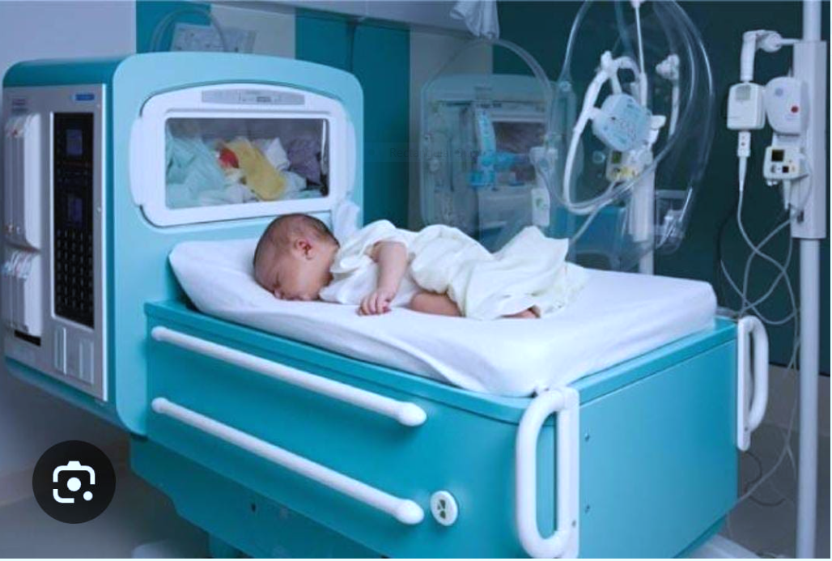
.
INNOVATIVE PROJECT LAB1(23ECE139)
AFFORDABLE AND PORTABLE WIRELESS INCUBATOR FOR
PREMATURE BABIES
Shreya Mouli G N Sangeeta S Gatti Poorvika M R
1BG23EC100 1BG23EC094 1BG23EC078
Under the Guidance of:
Prof Kiran K N
Assistant Professor-ECE-Dept

Slide 2
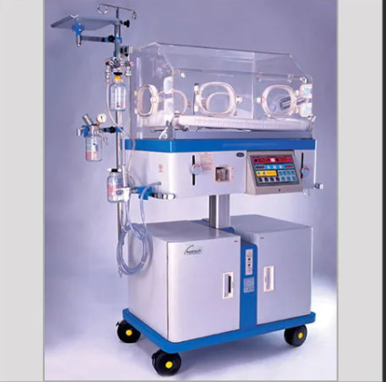
Contents
Introduction
Objective And Scope
Innovation
Literature Survey
Block diagram
Components required
Conclusion
References

Slide 3
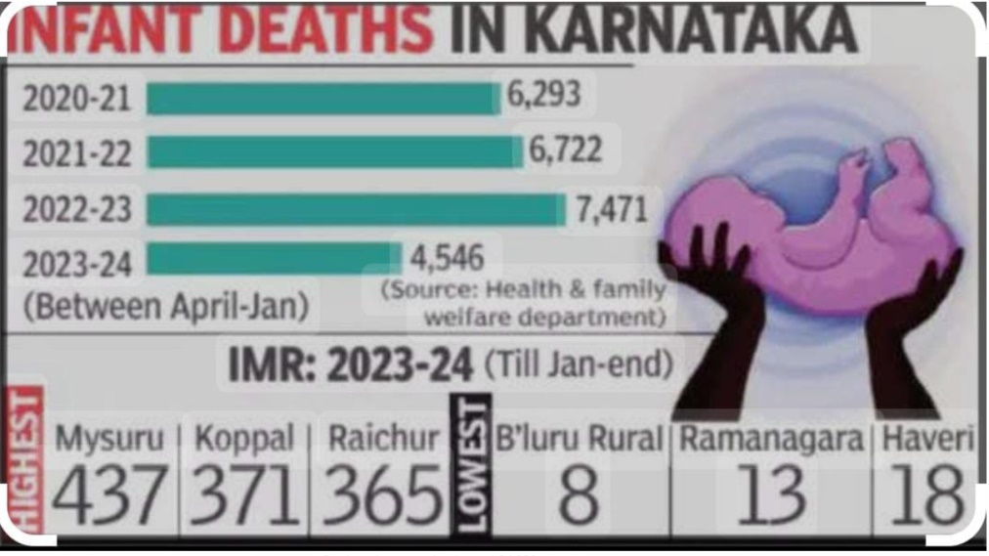
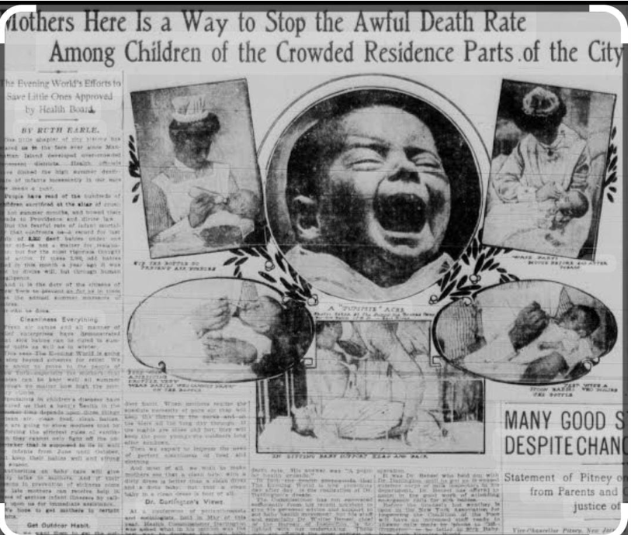
INTRODUCTION
1.The leading cause of child mortality globally is prematurity.
2.High cost of keeping babies in clinical incubator.
3.Specialized care, particularly in regulating their body temperature.
4.Traditional incubators are typically expensive and bulky.
5.A low-cost , life-saving solution for neonatal care.

Slide 4

OBJECTIVE AND SCOPE
To design and develop a low-cost incubator.
Portable wireless incubator.
Affordable , easy-to-transport.
Lightweight and compact design.
Wireless monitoring for real–time tracking.

Slide 5
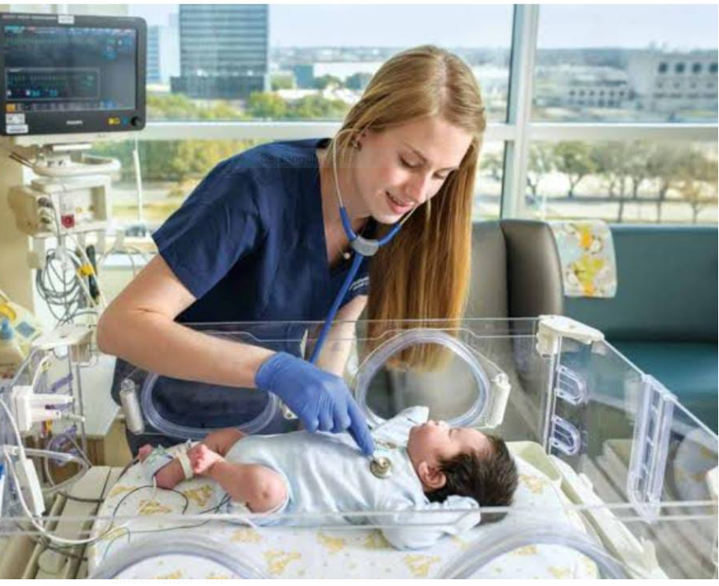
INNOVATION
Provision of continuous warmth.
Effective power consumption.
Sensors to monitor temperature conditions.
Cost effective.
No swaddling or wrapping of baby needed.

Slide 6
LITERATURE AND SURVEY
1.Embrace Infant Warmer:
Observations:
Affordable and reliable medical devices for emerging markets.
Resembles small sleeping bags, light weight and transportable.
Reducing infant mortality in low resource settings.
Key Takeaways
Potential for improvement areas like monitoring, continuous heating.
Effective for short term temperature regulation.
Low tech solution to operate.
1.1.Paper details Embrace Infant Warmer |  |  | TT

Slide 7
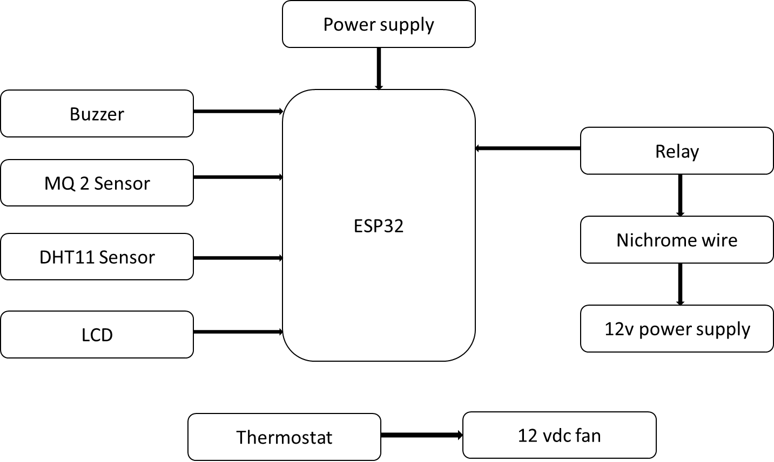
Block diagram

Slide 8
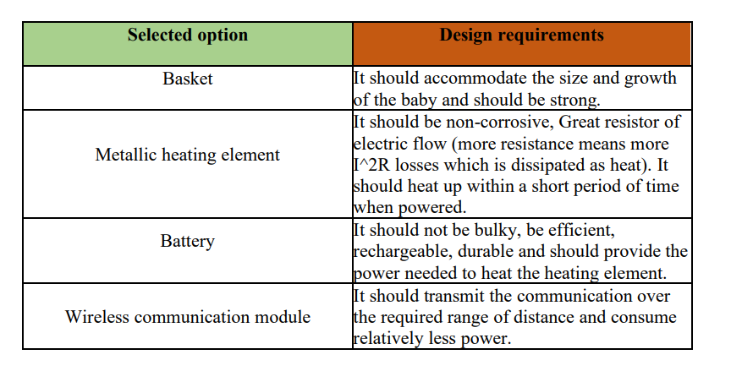
Design requirements of main components

Slide 9
BUDGET
Justdial incubator(12000/-)
Jetic healthcare private limited(mild steel) (23000/-)
C cube advance technology(1,24,250/-)
Affordable Incubator:
ESP32-500/-
Nichrome wire (5m)-25/-
Thermostat-145/-
LCD-150/-
Smoke sensor-151/-
DHT 11-165/-
Realy board(5v)-50/-
Buzzer-15/-
TOTAL BUDGET-820/-

Slide 10

Implementation
1.Temperature and Humidity Control
2.Light Intensity Detection
3.Gas Level (Smoke) Detection
4.SIDS Reduction
5.Malaria Prevention

Slide 11
Conclusion
Affordable and portable suitable with low resource settings.
Maintains a stable temperature.
User-friendly system.
Real time updates for both mother and pediatrician.
Equipped with sensors ensuring a safe environment for the baby.
Buckwheat hull mattress reduces the risk of suffocation.
Insecticide treated mosquito net effectively protects the baby from malaria.

Slide 12
References
1.Lamidi,Abd Kholiq, Muslim Ali
Indonesian journal of electronics, electromedical engineering and medical informatics 3(2),2021.
2. Rafa Raihan Fadilla
Department of Electrical Enginering, Brawijaya University ,Malang, East Java 65145,Indonesia.
3.R.J.Banu,”Neonantal Healthcare Monitoring in Incubator Using IOT” ,International Journal of Electrical,Electronics and Data communication,vol.6,np.6,pp.1-6,Jun.2018.
4.M.Shaib,M.Rashid,L.Hamawy,M.Arnout,I.E.Majzoub and A.J.Zaylaa,”Advanced portable preterm baby incubator,”2017 Fourth International Conference on Advances in Biomedical Engineering(ICABME),Beirut,2017,pp.1-4.

